Slide 1


The citizens’ voice on the ED
eCream Consortium Meeting 15-16 October 2026, Kosice
Iveta Nagyova
Department of Social and Behavioural Medicine
Faculty of Medicine
PJ Safarik University in Kosice, Slovakia
iveta.nagyova@upjs.sk

Slide 2
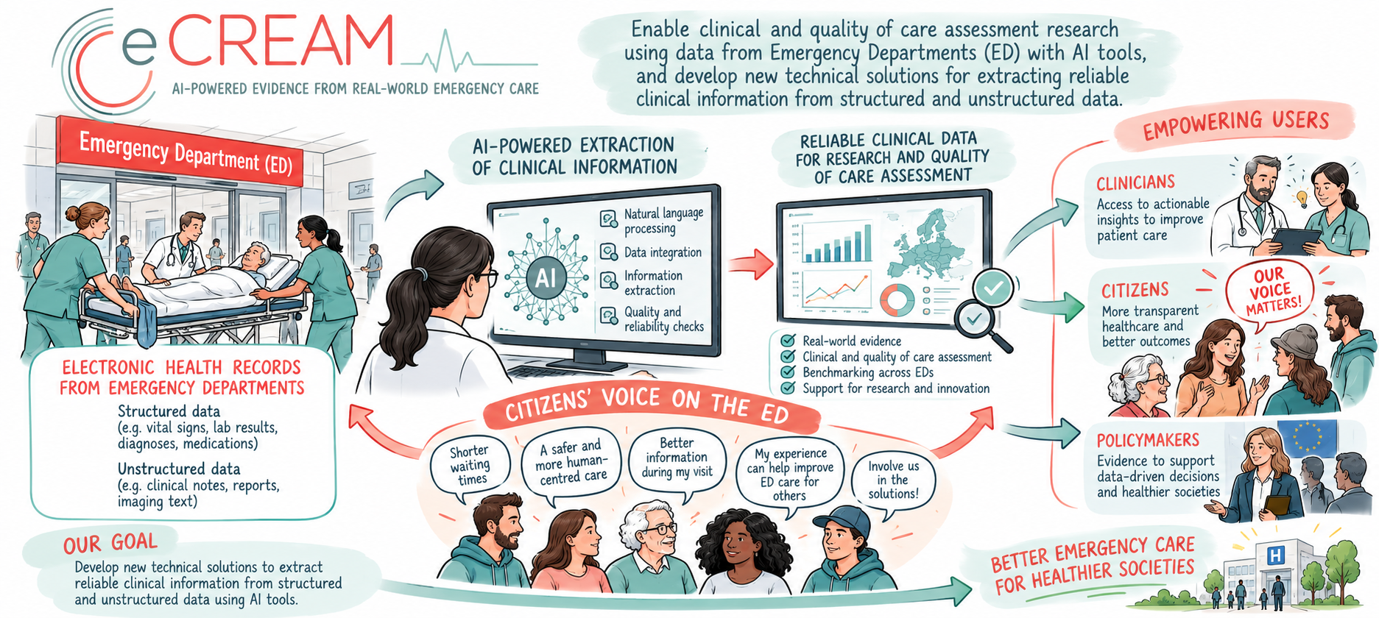

Slide 3
UC2 | How to design a citizen friendly tool?
Find tools already available
  Literature review
  Online survey
  Know citizens’ information needs, perspectives and experience
    Literature review
    Focus groups
    Ask citizens’ opinions on the prototype
    Semi-structured interviews
    Involve health professionals and citizens in developing the prototype
        Multidisciplinary working group

Slide 4
Team | UC2
Cinzia Colombo Italy – IRFMN
literature review, survey, focus groups, interviews
Iveta Nagyova Slovakia – UPJS Kosice
literature review, survey, focus groups, interviews
Justyna Danel Poland – UJCM
    literature review, survey, focus groups, interviews
Philip Goldenberg UK – Ashford & St Peter's NHS Trust
    survey
Luka Petravić Slovenia – UKC Maribor
    literature review, interviews

Slide 5

Team UPJS | UC2
Literature review, survey, focus groups, interviews
  Iveta Nagyova
  Zuzana Katreniakova
Literature review, survey
Vladimira Timkova
Pavol Mikula
Focus groups, interviews
  Marta Nemcikova
  Alexandra Husivargova Theofanidis

Slide 6
UC2 | How to design a citizen friendly tool?
Find tools already available
  Literature review
    Online survey
  Know citizens’ information needs, perspectives and experience
    Literature review
    Focus groups
    Ask citizens’ opinions on the prototype
    Semi-structured interviews
    Involve health professionals and citizens in developing the prototype
        Multidisciplinary working group

Slide 7
Literature review
Short protocol drawn up.
Main research questions and outcomes:
Are there dashboards that guide citizens’ decisions when choosing whether to go to EDs and what are their main characteristics?
Outcomes: number of dashboards per country and qualitative description of main characteristics.
Do citizens use these dashboards when choosing whether to go to EDs?
Outcomes: number of users, description of main characteristics of users /non-users.
What are citizens’ opinions on these dashboards?
Outcomes: rating or qualitative information on opinions of citizens (users and non-users)
Next steps: define the search strategy and retrieve resources, start international search
UPJS - Slovakia conducted a scoping review on the available citizens’ dashboard in Slovakia useful as background information and to define the framework of the overall literature review.

Slide 8
State of emergency care in Slovakia:
A scoping review
Main aims
To identify dashboards that guide citizens’ decisions when choosing whether to go to EDs and what are their main characteristics
Map existing literature regarding emergency care encounters, with an emphasis on the current state of emergency care services (ECS) in Slovakia
Identify barriers and enablers in efficient emergency care (EC), as well as healthcare professionals’ and users' perspectives in ECS

Slide 9
Methods | Frameworks & Guidelines
Population—Concept—Context (PCC) framework
We followed the Joanna Briggs Institute (JBI) guidelines for scoping reviews (Peters et al., 2020).
The results of this review will be reported consistent with the Scoping Review Extension of the Preferred Reporting Items for Systematic Reviews and Meta-Analyses (PRISMA-ScR) checklist (Tricco et al., 2018).
Tricco, A et al. (2018). PRISMA extension for scoping reviews (PRISMA-ScR): Checklist and explanation. Ann Internal Med 169,7: 467–73
Peters, M. D. J. et al. (2020). Chapter 11: Scoping reviews. In E. Aromataris & Z. Munn (Eds.) JBI manual for evidence synthesis. JBI.

Slide 10
Methods | Information sources
Bibliographic databases were searched from Jan 2015 to May 2025
DATABASES
Web of Science, PubMed, CINAHL, Embase, and Cochrane Library Desktop search was conducted by two authors (VT, PM)
We searched also Google Scholar. Grey literature was searched including newspaper articles, television reports, national registers, government data, policy documents, healthcare-affiliated organizations, commentaries, dissertations, and conference abstracts.
GREY LITERATURE
Exclusion criteria: guidelines, technical reports, economic
evaluations, letters to editor

Slide 11
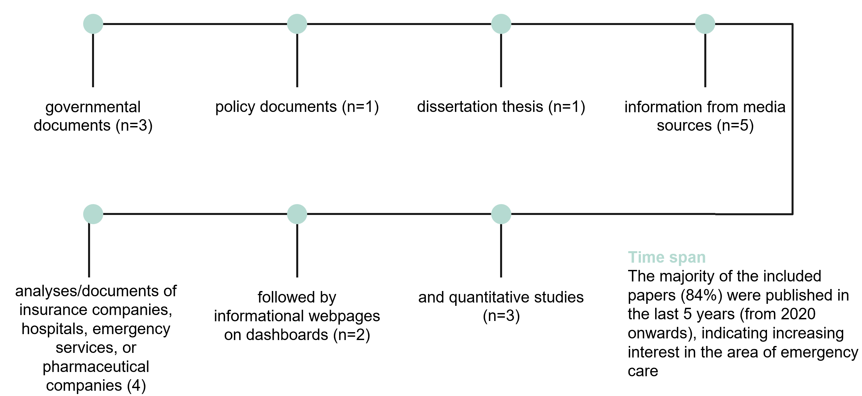
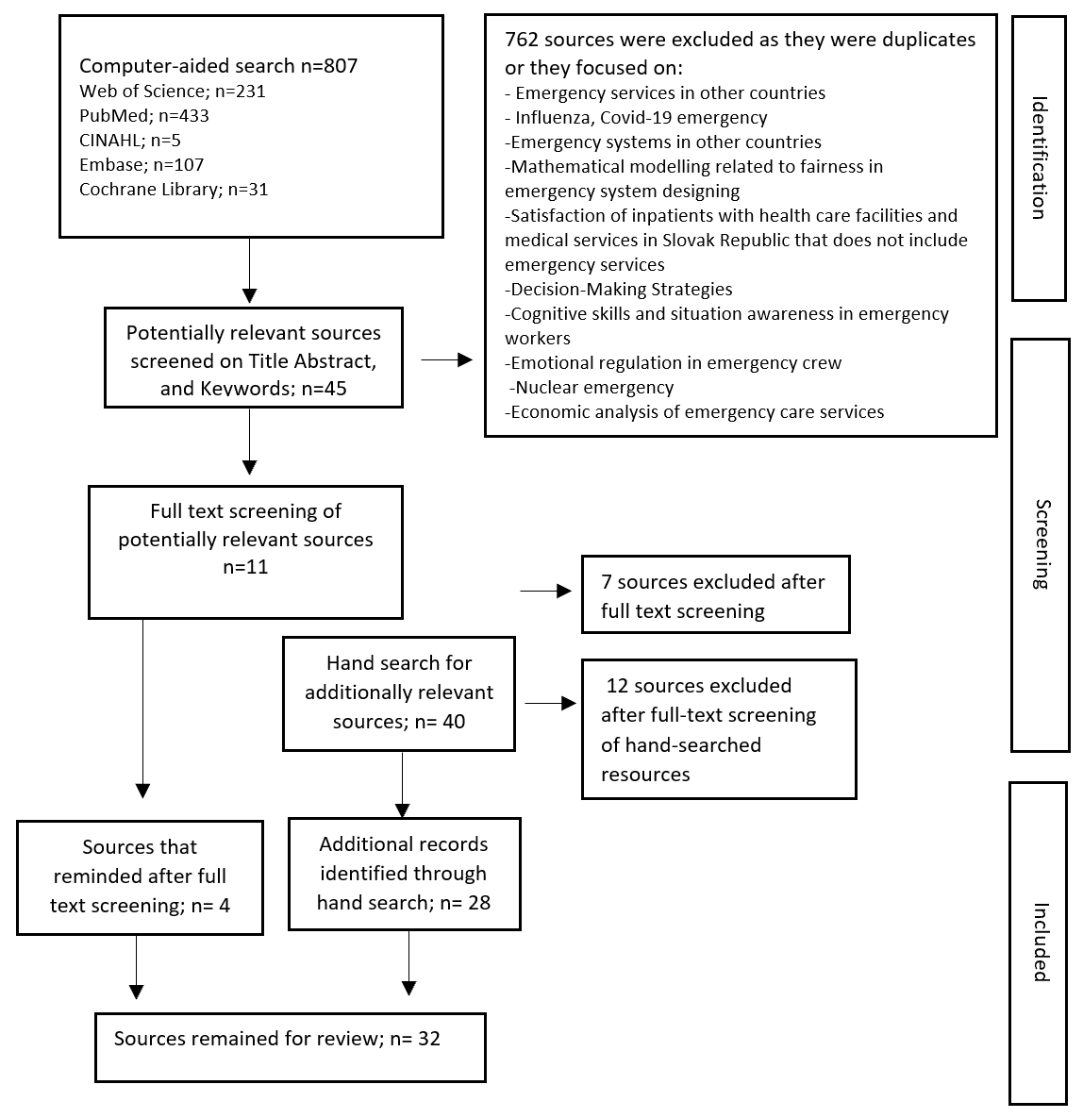
Results | Type of Sources | Flowchart
Computer-aided search n=807 -> 781 excluded -> Sources remained for review; n= 33

Slide 12
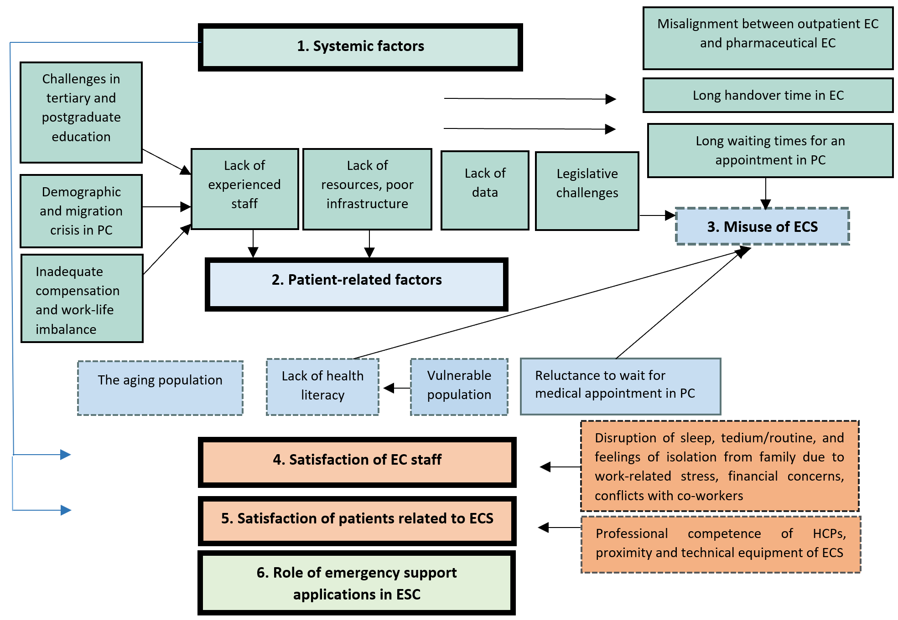
Results | Key themes related to the state of EC in Slovakia
Notes:
1. Lack of resources: Slovakia was one of the few countries that did not have the ECS meeting the European Union standards, with only 3 hospitals fulfilling the EU criteria. Training of medical staff 40-50% English; 20% Slovak’s abroad; demanding training 5-years intensive training fever that 10 in past 5 years (SK, CZ); Ageing physicians GP mean age=57 years; 59 peadiatric. No. of phys 3,7 vs 4,1 /1000, nurses 5,7 vs 8,5. Pharmacies only 5% are located near ECS facilities; 41% are not visited during emergency hours
2. Homeless, alcohol abuse; lack of manners
3. Legislative: Misuse of the system - “costly transportation service” (Veselá, 2020). Absence of clear legislative definitions of service misuse or the lack of established sanctions for such misuse.
4. Satisfaction of EC staff. Many of the HCPs complete overnight emergency shifts and subsequently resume routine practice the following morning without adequate rest. The cumulative burden of extended working hours often accelerates decisions by current practitioners to leave the profession (MoH SR, 2022).
5. Satisfaction of patients. Behaviour of the staff, long waiting times, or poor seating amenities in the waiting room. Satisfaction with ECS 1,5-2 (1=best, 5 =worst); 77% were satisfied

Slide 13
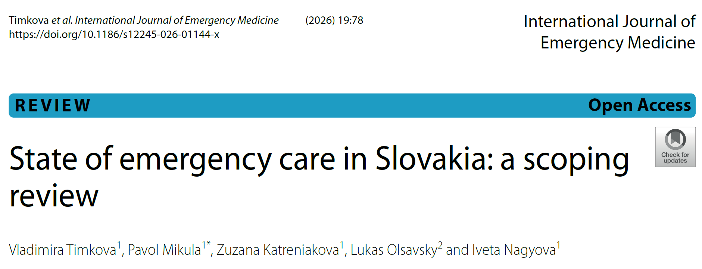
Results | Key themes related to the state of EC in Slovakia
IF 1.9 | Q2 - JCR
Notes:
1. Lack of resources: Slovakia was one of the few countries that did not have the ECS meeting the European Union standards, with only 3 hospitals fulfilling the EU criteria. Training of medical staff 40-50% English; 20% Slovak’s abroad; demanding training 5-years intensive training fever that 10 in past 5 years (SK, CZ); Ageing physicians GP mean age=57 years; 59 peadiatric. No. of phys 3,7 vs 4,1 /1000, nurses 5,7 vs 8,5. Pharmacies only 5% are located near ECS facilities; 41% are not visited during emergency hours
2. Homeless, alcohol abuse; lack of manners
3. Legislative: Misuse of the system - “costly transportation service” (Veselá, 2020). Absence of clear legislative definitions of service misuse or the lack of established sanctions for such misuse.
4. Satisfaction of EC staff. Many of the HCPs complete overnight emergency shifts and subsequently resume routine practice the following morning without adequate rest. The cumulative burden of extended working hours often accelerates decisions by current practitioners to leave the profession (MoH SR, 2022).
5. Satisfaction of patients. Behaviour of the staff, long waiting times, or poor seating amenities in the waiting room. Satisfaction with ECS 1,5-2 (1=best, 5 =worst); 77% were satisfied

Slide 14
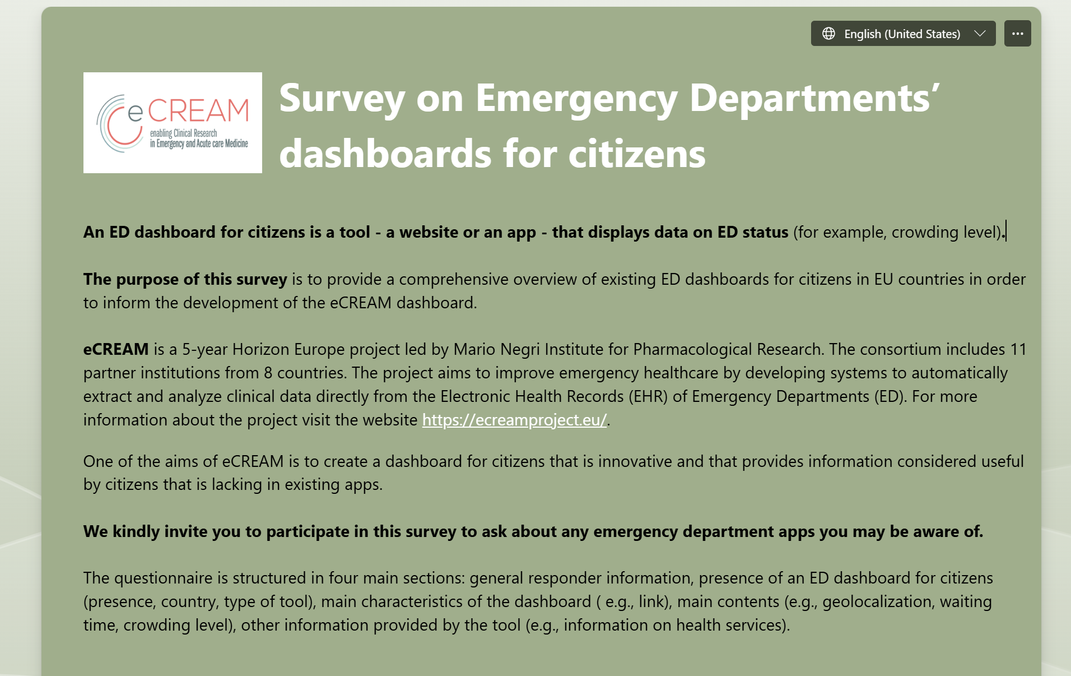
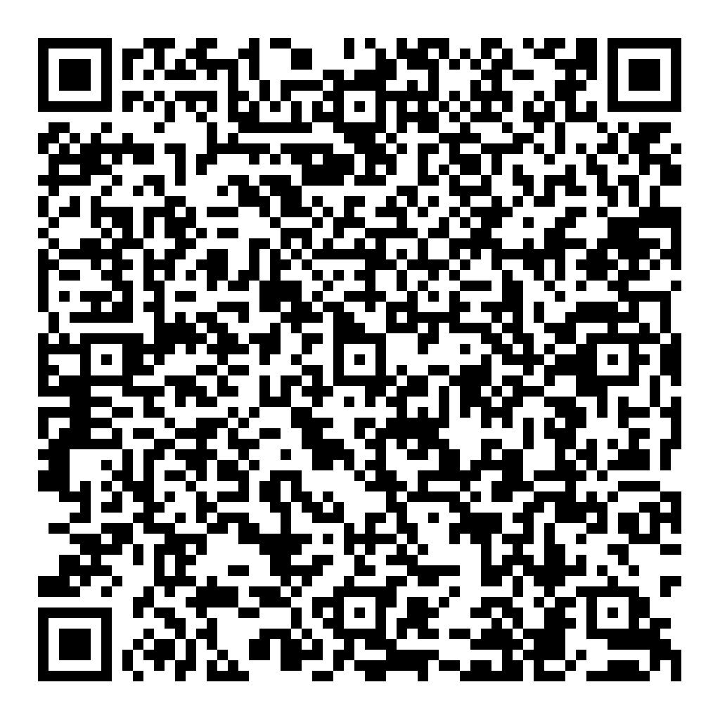
Online survey

Slide 15
Online survey
Main questions, based on the preliminary survey
Are there dashboards that guide citizens’ decisions when choosing whether to go to EDs in your country?
Do they provide information on:
  crowding level
  n. of people present
  n. of people arriving from the national emergency number
  n. of people waiting
  waiting time
  n of people under treatment/visiting
  n. of people under observation
  n. of people treated
  n. of people waiting for discharge or transfer
  n. of people discharged or transferred
  "Search for patient": through triage code - possibility to see the "state" of the person in the ED
  geo-localization /map
Is there a function for checking symptoms?
Is there any further information? Please, specify

Slide 16
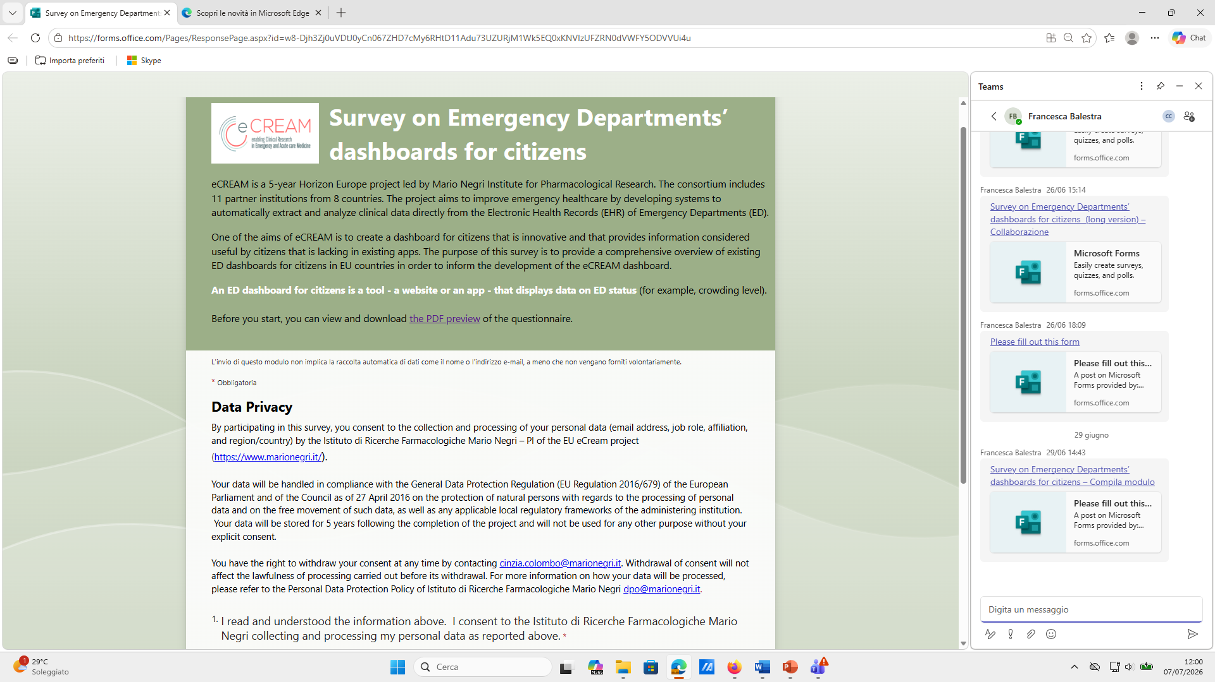
  Short description of eCream
  Data Privacy statement
  Consents to data processing and to the survey
  Email address
  Affiliation
  Is there any dashboard for citizen in your Country?
  If Yes, please specify the Country
Dashboard’s characteristics -Type of tool
  Website
  App
  Both
Please provide the link

Slide 17
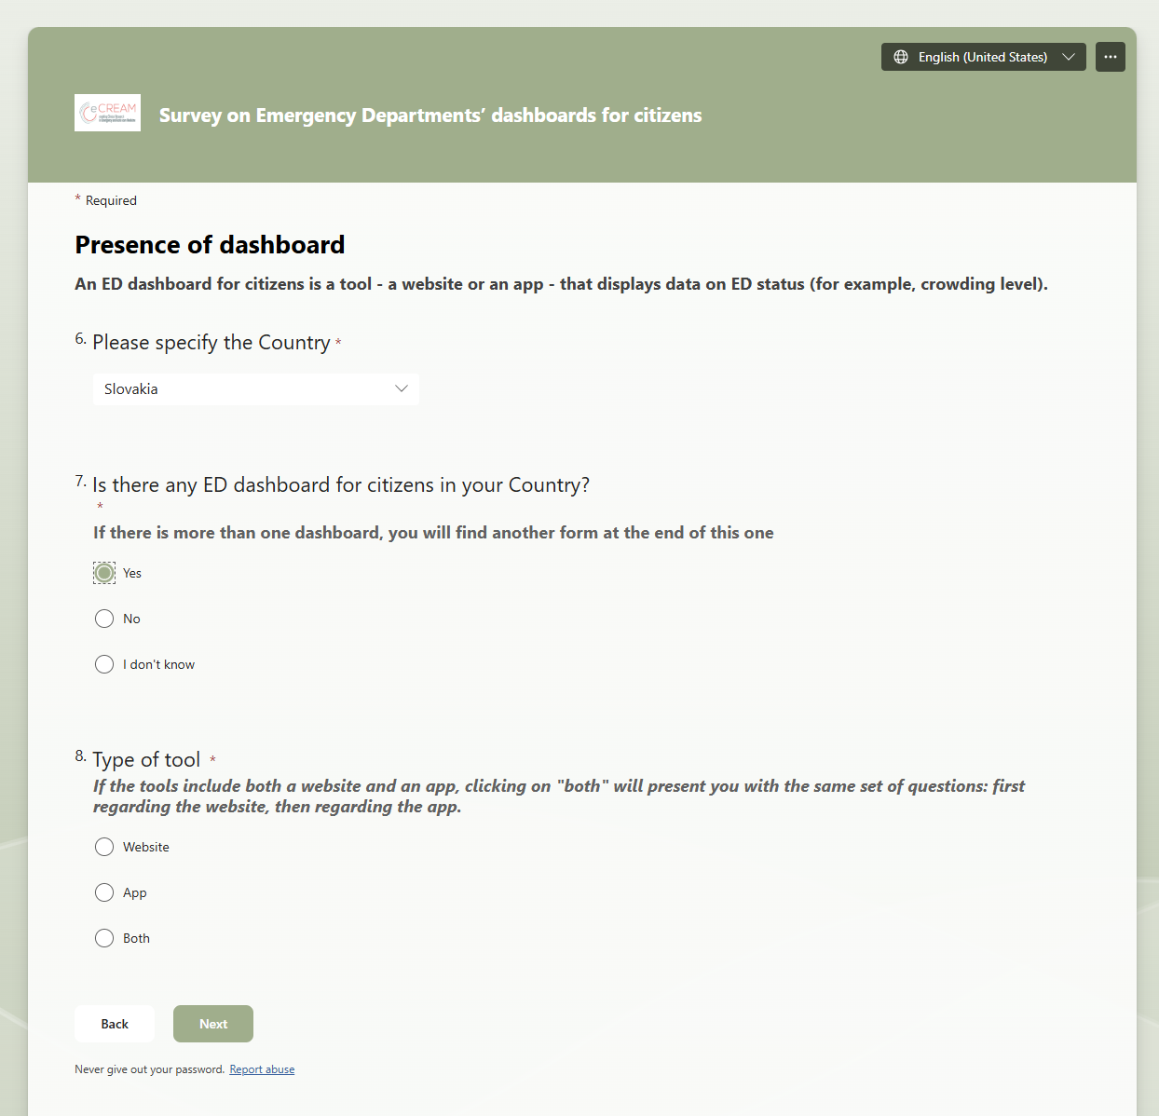
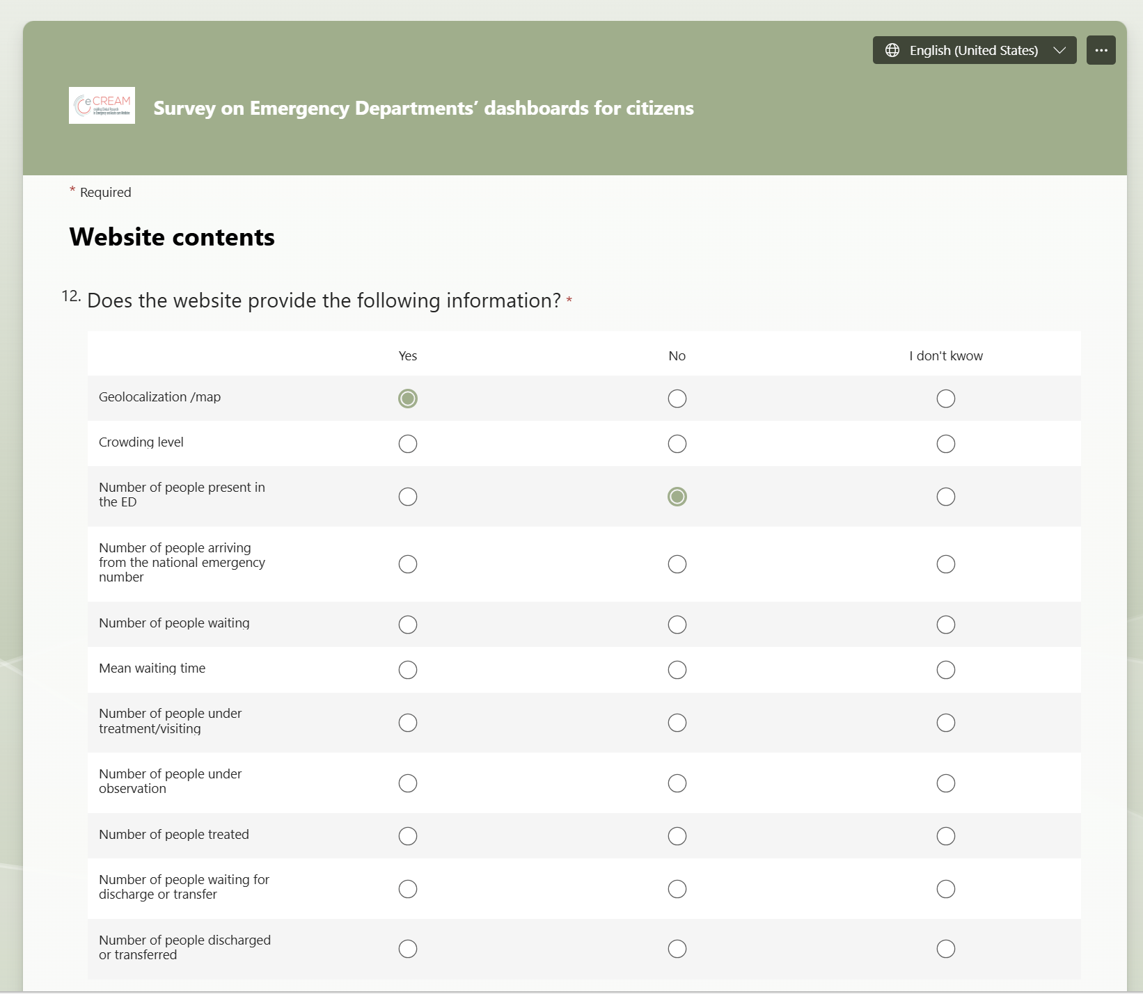
Online survey

Slide 18
Online survey | Results (preliminary)
  Launch: 2 October 2026
  Data collected so far:
  Italy: 13
  Slovenia: 5
  Grece: 2 – but with some reservations
  Slovakia: 0 – needs to be translated into Slovak language
  Poland: 0 – needs to be translated into Polish language
  UK: 0

Slide 19

Focus groups | State of the art
  Timeline:
  First FG documents sent to Cinzia: Mar 2025
  FG protocol fine-tuning: Mar 2025-Apr 2006
  Draft eCREAM FG protocol ready: Apr 2026
  Feedback from partners: April – Jul 2026
  UC2 consolidation meeting: 24 Jul 2026
  Upgrading the protocol: July – Oct 2026
  Consultations and fine-tuning v2.0: Oct 2026
  Next steps:
  Obtaining local/national ethics approvals: Oct – Nov 2026
  Data analysis: Qualitative data | MAXQDA or NVivo

Slide 20


THANK YOU
FOR YOUR
ATTENTION
eCREAM@marionegri.it

Slide 21


